Slide 1



HOLMENA

Slide 2


Intro
01
Outline
Problem
02
Our Solution
03
Market Focus
04
Business Model
05
Competitive Analysis
06
Marketing
07
Demo
08
Team
09
Ask
10

Slide 3


Introduction
Mohamed Rashad Rouine, Entrepreneur and founder of HOLMENA.
Our team specializes in IT, marketing, and innovation
We acknowledge MENA’s IT challenges
Notes:
Hello everyone, I'm Mohamed Rashad Rouine, founder of HOLMENA. Our team brings together years of experience in IT project management, digital marketing, and innovative software solutions. Through our collective journey, we've identified critical challenges in the MENA region's IT landscape.

Slide 4

Problem Statement
    Digital lag is costing MENA region trillions in losses
    50% of MENA small businesses lack a digital presence
    70% of MENA companies face high IT costs due to outsourcing
    1 in 6 IT projects have 200% cost overruns
    31% of IT projects are canceled
Notes:
We noticed how cumbersome and expensive digital solutions could be, in both public and private sectors.
We noticed also the importance of digital solutions and a digital presence for companies.
We realized the high cost of IT projects, often outsourced to foreign companies, places a heavy financial burden on local businesses.
Brain drain and inadequate digital infrastructure for digital jobs led to a lack of expertise in technology and innovation
These issues stifle the potential of businesses to fully leverage digital transformation.
70% of MENA companies face high IT costs due to outsourcing (Middle East Institute).
45% of tech talent leaves the region (Gulf News).
30% of MENA startups access affordable IT solutions (Arab News).
50% of MENA small businesses lack a digital presence (PwC Middle East).
31% of IT projects are canceled (Standish Group).
52% of IT projects exceed cost estimates by 189% (McKinsey & Company).
1 in 6 IT projects have 200% cost overruns (Harvard Business Review).

Slide 5

Our Solution
    Tailored IT solutions for specific business needs
    Delivering Custom Digital Solutions
    Leverage local talent to reduce costs and retain expertise in the region
    Utilizing Regional Expertise
    Investing in Innovation
    Continuous R&D, adoption of latest technologies
Notes:
- Delivering Custom Digital Solutions : Developing high-quality solutions locally, reducing costs and retaining expertise within the region.
- Utilizing Regional Expertise : Utilizing our extensive experience to create bespoke IT solutions that meet specific business needs, ensuring efficiency and scalability.
- Investing in Innovation : Continuously investing in R&D, adopting the latest trends and technologies to provide cutting-edge solutions.

Slide 6

Market Focus
Aspect | Details
Target Market | - Small startups and businesses in the MENA region - Sectors: eCommerce, fintech, healthcare, logistics, IT
Market Potential | MENA eCommerce market: $37B (2022) to $57B (2026) MENA IT market: $20.4B (2020) to $31B (2025) MENA digital economy growth: 20% annualy
Notes:
Our initial target market includes small startups and businesses, particularly those in need of affordable, high-quality IT solutions. By starting within the MENA region, we leverage familiarity with local business environments, cultural nuances, and communication preferences.
Market Definitions: Key sectors such as eCommerce, fintech, healthcare, and logistics are heavily reliant on technology.
Market Attributes:
Over 50% of small businesses in the MENA region lack a digital presence.
The digital economy in the region is expected to grow by 20% annually​ (Gulf Business)​​ (Bain)​.
Only 30% of startups have access to affordable, quality IT solutions​ (Gulf Business)​​ (Bain)​.
The MENA eCommerce market reached a value of $37 billion in 2022 and is projected to grow to $57 billion by 2026, with a compound annual growth rate (CAGR) of 11%​ (Gulf Business)​​ (Bain)​.
By focusing on the MENA region, we can cater to a market that is rapidly digitizing and increasingly in need of comprehensive IT solutions, particularly for sectors like eCommerce and fintech which are experiencing substantial growth.

Slide 7






Business Model
Custom Digital Solutions
Mass-Market Digital Products
Remote and On-Site Expertise
Notes:
- Custom Digital Solutions : Design bespoke digital solutions tailored to each client's requirements, which serve as our day-to-day earners.
- Mass-Market Digital Products : Develop scalable products that address common challenges across similar industries, which have the potential to be our big earners.
- Remote and On-Site Expertise :Create opportunities for local tech talent to work both remotely and on-site, combating brain drain and ensuring top-notch service quality at affordable prices.

Slide 8
Competitive Analysis
Company | Cost | Quality | Expertise | Focus
HOLMENA | Affordable | Moderate to High | MENA digital Expertise | Startups & SMEs
Tntra | High | High | Broad | Various
BoTree | Moderate | High | Technological Expertise | MENA Startups
Nexel Partners | Moderate | Moderate | Niche Services | Various
10X DS | High | High | AI & Automation | Large Enterprises
Avaali Solutions | High | High | Enterprise Focus | Large Enterprises

Slide 9

Marketing
Affiliate Programs
Offline Marketing
Online Marketing
Notes:
Online Marketing:
SEO, social media campaigns, email marketing, and PPC advertising.
Offline Marketing:
Networking events, industry conferences, and printed materials.
Affiliate Programs:
Partnering with local influencers and industry leaders.
Partnerships:
Collaborating with regional business hubs and incubators to reach more startups.
Target Audience:
Entrepreneurs, small business owners, and tech startups in the MENA region.

Slide 10
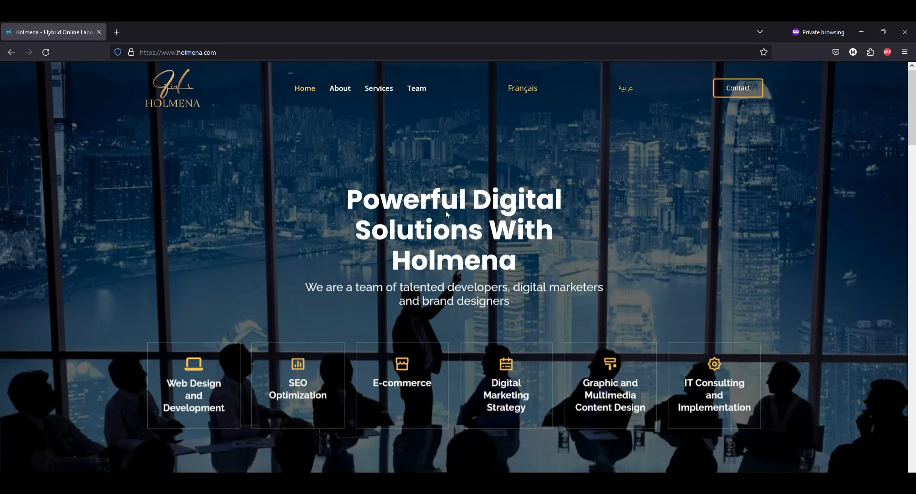
Demo

Slide 11
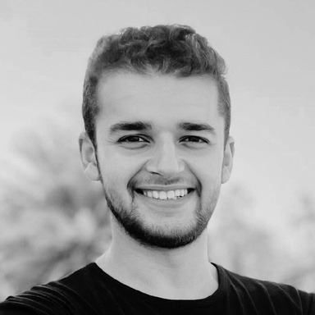
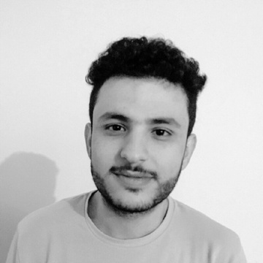
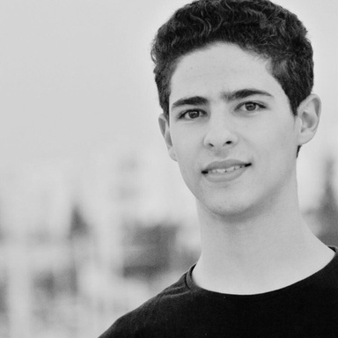
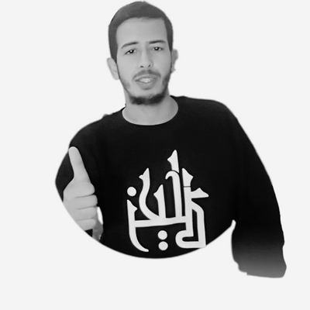
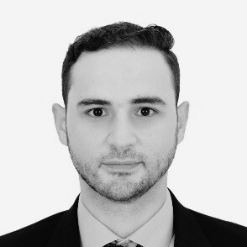
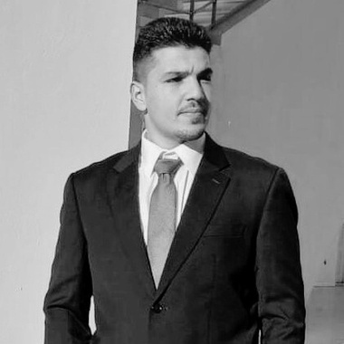
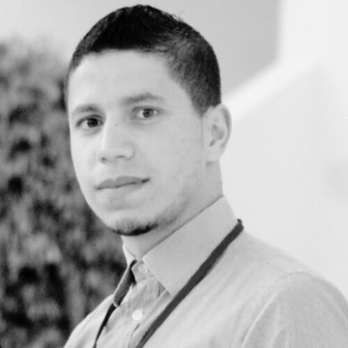
TEAM
Mohamed Rashad Rouine Founder
Strategic direction and operations.
Mohamed Amine Othmani
CEO
Leadership, innovation and business intelligence.
Mohamed Abbes
Technical Director
Technology strategy and implementation.
Saleh Alaya
Director of CyberSecurity
Robust security protocols and practices.
Abedrrahmen Rouine
Sales Director
Sales strategy and customer acquisition.
Ahmed Fathalli
Head of Growth
Business development and market expansion.
Ahmed Missaoui
Chief Designer
Branding and social media management.

Slide 12


Ask
We ask you to
Spread the Word
Collaborate with Us
Join our digital network
Notes:
We ask you to join our network and be part of our journey to revolutionize the digital landscape in the MENA region.
- Help us reach more businesses in need of affordable, high-quality digital transformation services, get a commission !
- Partner with us on projects to leverage our innovative solutions.
-What are your dreams? We will help you achieve them while investing in technology in the most optimized way possible !

Slide 13
Thank you for your attention!
Any questions ?

